Slide 1
Eyes Wide Shut? Exploring the Visual Shortcomings of Multimodal LLMs
Presenter: Kim Seung Hwan (seunghwan.kim@snu.ac.kr)

Slide 2
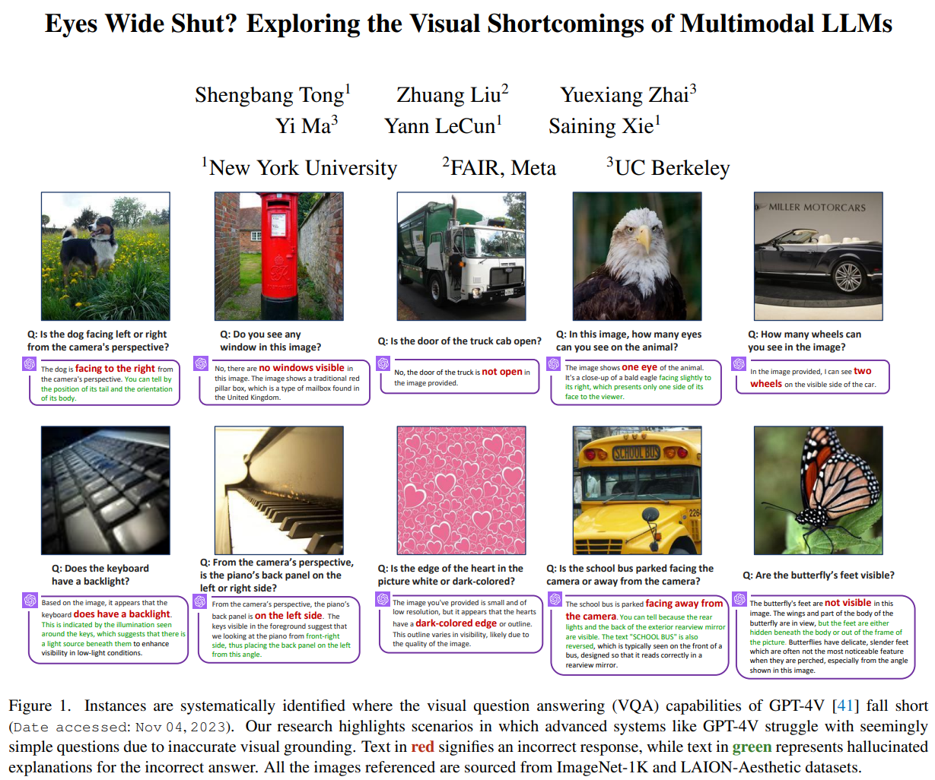

Slide 3
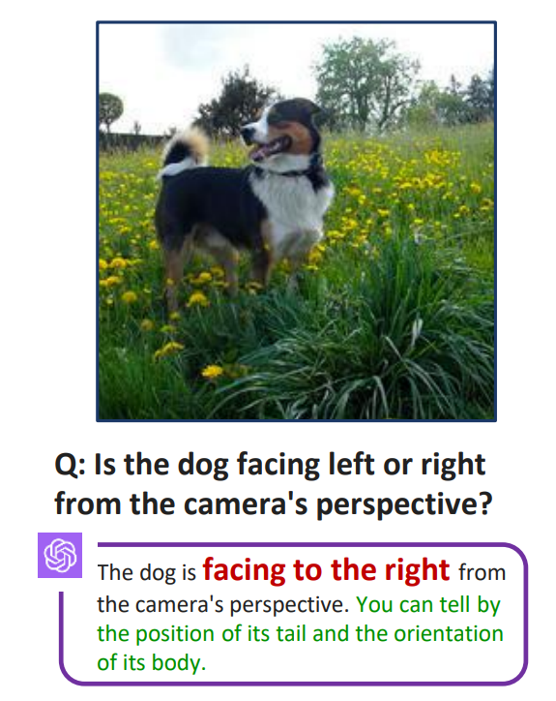
Problem
Strong VLMs (e.g. GPT-4V, Gemini) excel at complex reasoning but fail at perceiving elementary visual feature
Do these shortcomings from (1) vision encoder, or (2) LLM?

Slide 4
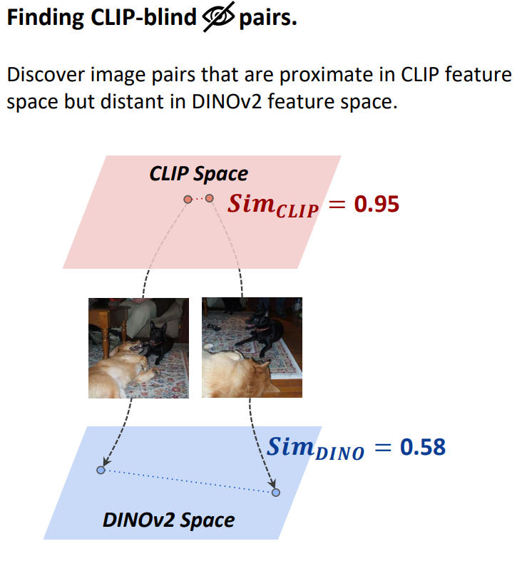
Problem
Answer: vision encoder
The CLIP base vision encoder itself that many models use is not very good

Slide 5
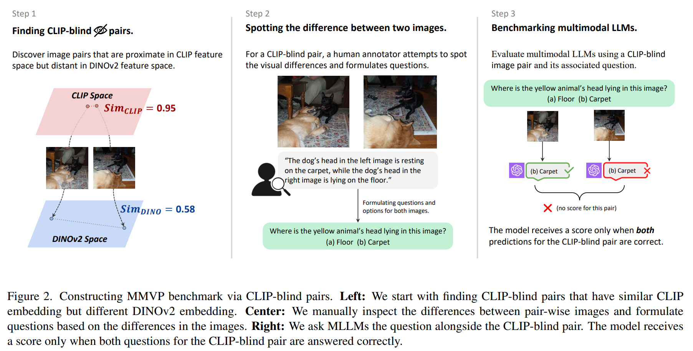
Benchmark

Slide 6
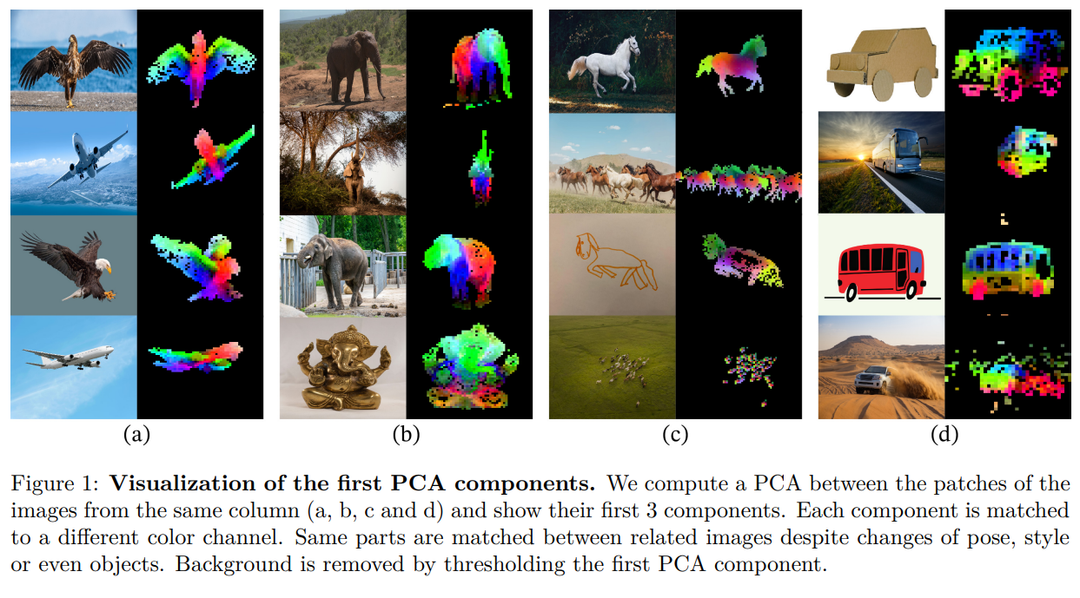
Benchmark
Finding CLIP-Blind Pairs
Using DINOv2

Slide 7
Benchmark
Designing 150 pairs with 300 questions
By human annotator

Slide 8
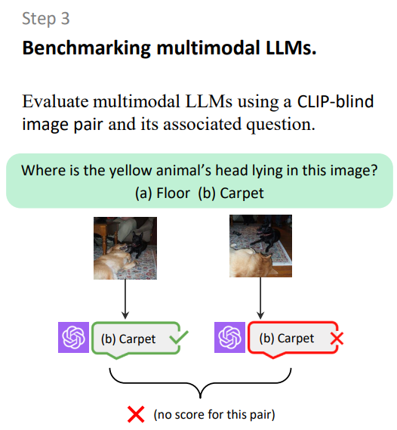
Benchmark
Assess with:
LLaVA-1.5
InstructBLIP
Mini-GPT4
GPT-4V
Gemini
Bard

Slide 9
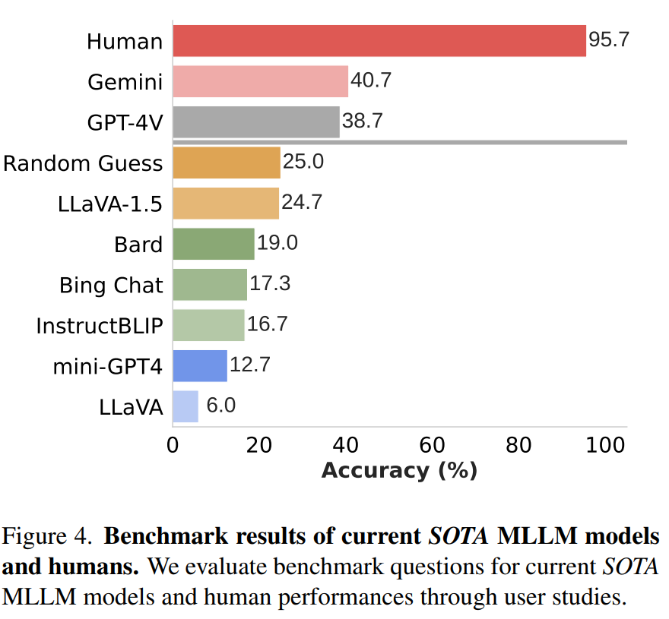
Benchmark
Human confirms questions are straightforward
But SOTA VLMs fail

Slide 10
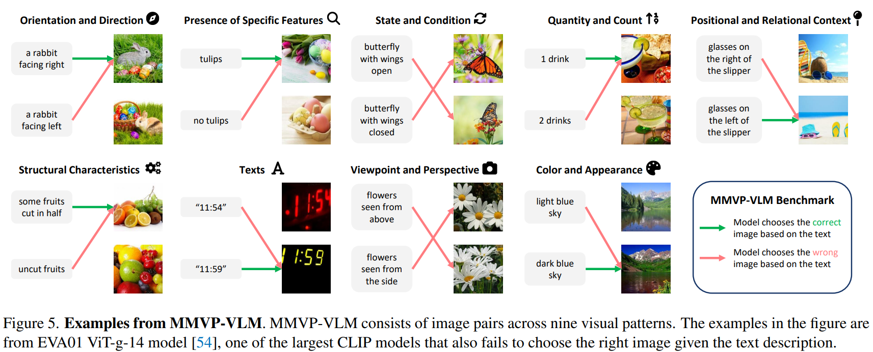
Benchmark

Slide 11
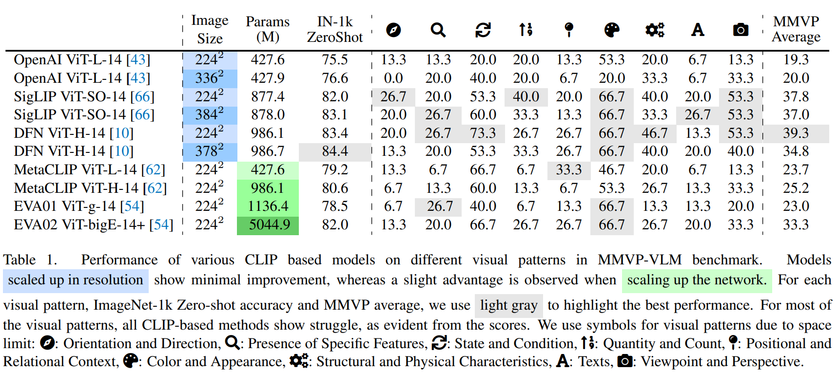
Benchmark

Slide 12
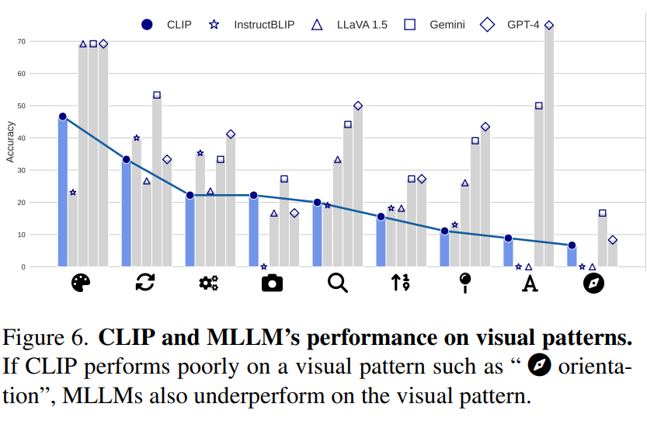
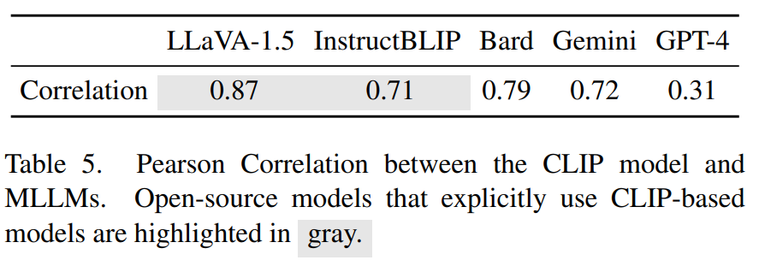
Benchmark
Its failure is inherited by VLM!

Slide 13
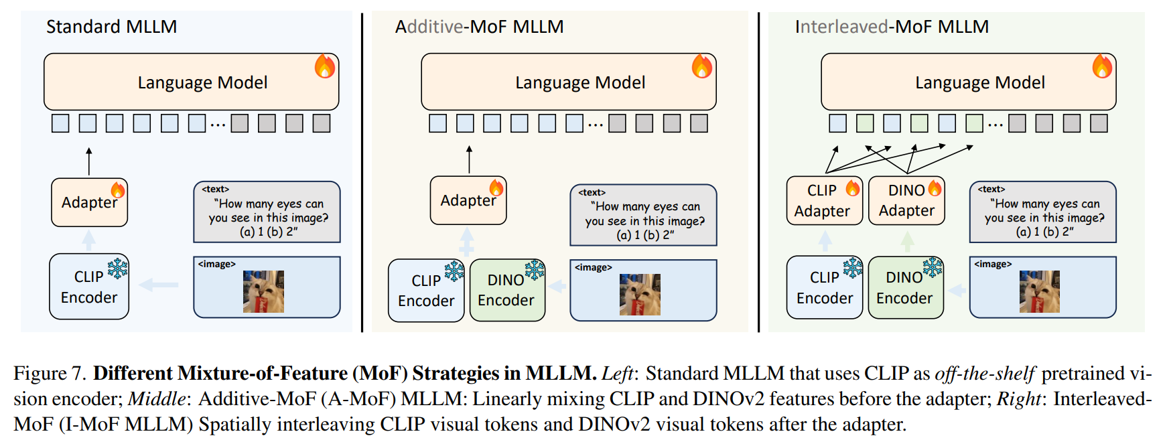
Method
They proposed very basic solution: just use DINOv2’s features too

Slide 14
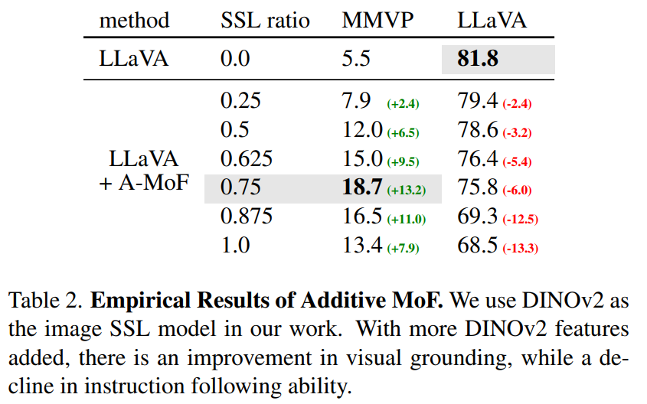
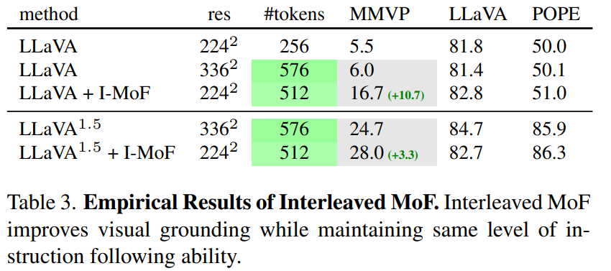
Method
Additive MoF shows trade-off
Visual detail vs. Instruction following
Interleaved MoF exhibits consistent results

Slide 15
Takeaway
A well-written paper with a natural flow
Focus on concept proof and analysis rather than complex method
Root: domain shift from CLIP's original pre-training task

Slide 16
Plus
What are the limitations of the uncertainty paper?
Inefficient
Still anchor-based
Postprocessing is overly simplistic
How can we solve it in continuous time?
Is there a more optimal question format?
What we're using isn't a simple logit, it's a probability
Can we exploit it further?

Slide 17
Thank you for listening
Presenter: Kim Seung Hwan (seunghwan.kim@snu.ac.kr)

